Slide 1
Natural Language Processing: Mandate - 1
Linguistics Fundamentals

Slide 2
Language
Read through this passage, and respond with what transpired in your minds:
“Once there lived a group of monkeys in a mountain slope. During the winter, they were unable to stand the severe cold and heavy rains. Mistaking red berries for embers of fire, they collected some of the wild red berries and gathered around to blow air.
Watching their vain effort in amusement, Suchimukha, a bird, told them, "You fools, they are not embers but red berries. Why do you waste your energy on them? This will not save you from cold. Go and look for a shelter in a cave or a place free from wind. The clouds are thick and there will be no immediate relief from rain."
An old member of the monkey gang angrily told the bird, "Why do you poke your nose in our affairs? Go away. Haven't the elders said that he who cherishes his welfare should not talk to a gambler or an inefficient workman. So is the person a fool who talks to an idiot or a pleasure seeker."
Disregarding the old monkey's anger and not giving room to any other monkey to talk, Suchimukha went on repeating his advice to them to seek shelter elsewhere. Tired with the bird's unwanted advice, one of the monkeys sprang at the bird and bashed him against a rock till he was dead.
Karataka said at the end of the story, "If you counsel a fool it will only provoke him and not pacify. If you feed milk to a snake it will increase its store of poison. That's why you should not offer advice to everyone. Look, how two good sparrows lost their home, all due to a foolish monkey."”
Passage Source: https://www.talesofpanchatantra.com/works/book1-the-separation-of-friends

Slide 3
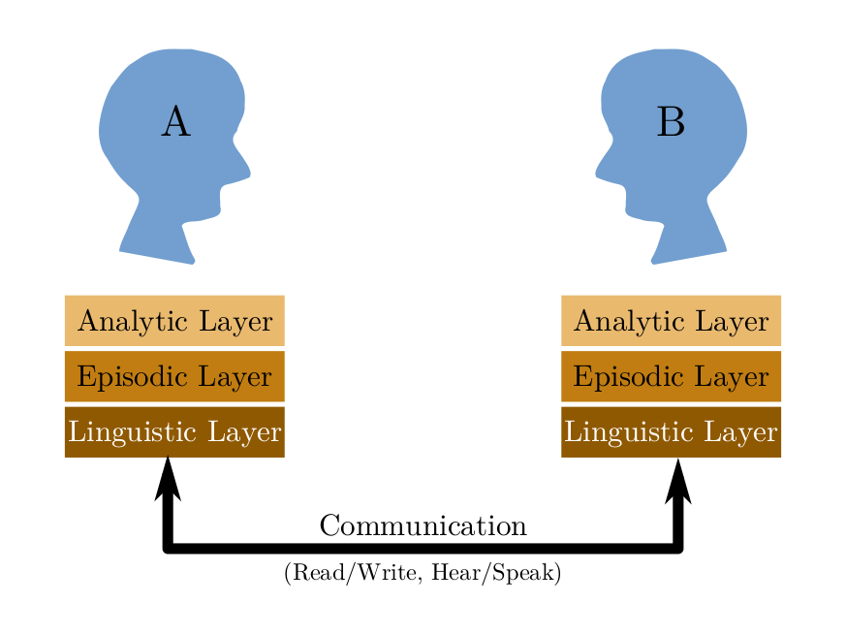
Language
Humans have two capabilities that are much more developed than other animals: conceptual modeling, and the language instinct
Humans can build rich, abstract models of both real and imaginary words, and communicate semantics with rich enough precision to induce a similar conceptual model in the recipient.
Natural Language Processing (NLP) addresses the human language instinct and tries to replicate it on computers.
3-layer model of semantic processing and communication in humans

Slide 4
Language
Language ability is not unique to humans. Many forms of linguistic constructs are found in animal societies:
Bee dance
Ant pheromone trails
Deer symbolics
etc.
Human languages too have evolved in its shape and form over history-- revealing more insights into our language instinct
Structure of human language has historically been determined by technological constraints of codification, communication and preservation

Slide 5
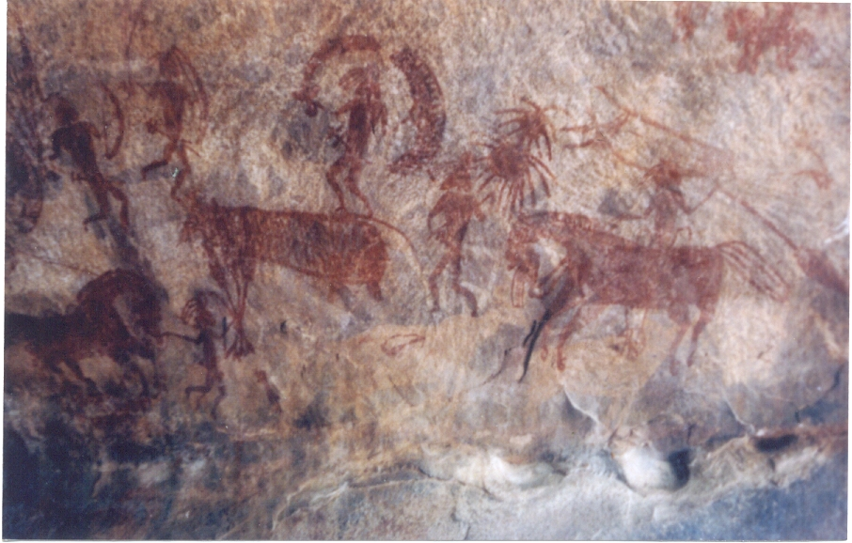
Language
Semiotics
Early forms of human language used signs and symbols-- often explicit characterization of objects
Study of signs and symbols is called Semiotics
Signs can be communicated in various forms including: visual, auditory, tactile, olfactory, or gustatory (taste)
Semiotics still used in different forms today (colour coding, traffic signs, etc.)
Bhimbetka rock paintings, Madhya Pradesh, ca 8000 BCE. Image Source: Wikipedia

Slide 6
Language
Semiotics
East Asian linguistic constructs influenced by semiotics to represent concepts directly
Individual letters in such a language are called logograms-- representing words, morphemes or entire concepts
Chinese translations for the following terms show semiotic representations:
Big: 大 (Da)
Small: 小 (Xiao)
Main Door: 大门 (Da Men)
Country: 国 (Guo)

Slide 7
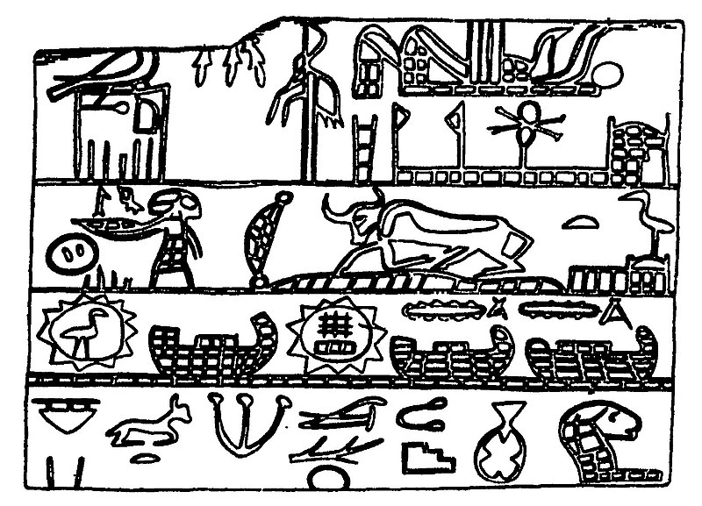
Language
Glyphs and Alphabet
Many ancient cultures like Egypt, Babylonia, Mesopotamia, developed derivative meanings when pictograms are combined together.
These are called hieroglyphs and are the precursor to modern alphabet.
Example:
pronounced st represents a seat or throne
Joined with a representation of a structure, indicates a house
By William Matthew Flinders Petrie ((3 June 1853 – 28 July 1942) - A history of Egypt Published in 1894, Public Domain, https://commons.wikimedia.org/w/index.php?curid=77728681

Slide 8
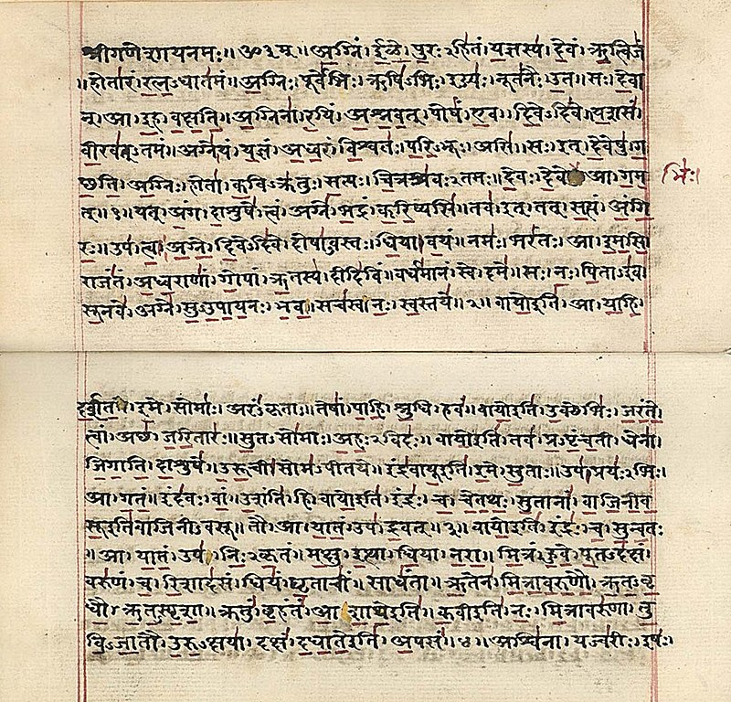
Language
Morphemes, Phonetics and Actors
Most Indian languages developed from the formal model of Classical Sanskrit, developed by Panini in his work, Asthadhyayi dating back to 6th century BCE
Sam-skrut literally means “arranged well together”
Language organized using the following constructs:
Vowels
Consonants organized based on sounds coming from different parts of our mouth
Morphological forms of vowels and consonants to build syllables (no need for spelling)
Morphological forms of words to indicate their role (Karaka-Vibhakti) and agglutination
Sanskrit original rendition of a part of the Rg Veda. Image Source: Wikipedia

Slide 9
Language
Word Orders
Word morphological forms to indicate role played by the word in a sentence (Karka) gives the property of free word order for most Indian languages.
Because of this, words can be written in any order without changing the meaning of the sentence (but may alter the relative emphasis).
Example:
श्यामने सूरजको बधाई दिया
सूरजको श्यामने बधाई दिया
बधाई सूरजको श्यामने दिया
In languages like English, word orders are more restricted, and appear mostly in the following form (active voice):
Subject -- Verb (Predicate) -- Object
Example:
Shyam complimented Soora
Subject
Verb
Object

Slide 10
Language and Thought
The interplay between language and thought is a matter of considerable debate
Thought molds and shapes our linguistic constructs, but linguistic constructs also affect and/or bias our thinking in specific ways
For example, in most Indian languages, we cannot say the following: “Yesterday evening, I went to a movie with my friend” without specifying the gender of the friend
Does language shape thought? https://randomgraphs.blogspot.com/2013/03/does-language-shape-or-distort-thought.html
Linguistic relativity and Linguistic determinism
Mould hypothesis:
Language is the clay that is moulded by thought to form a given shape. Without the clay, the thought may never be communicated
Cloak hypothesis:
Language is like a cloak that covers and packages thought. To understand the underlying meaning of thought, we should discard the cover.
Sapir-Whorf Hypothesis http://visual-memory.co.uk/daniel//Documents/short/whorf.html

Slide 11
Language and Thought
Analytic Philosophy
“Simpliciter” property of concepts and mental objects
Strong association between concepts and sounds
Assign the shapes with one of the following names: kiki, blooploop, hisss
Ordinary Language Philosophy
Degree of separation between terms and their meanings
“Meaningless” terms taking on meaning based on context of usage
Evolution of association between terms and meanings (“awful” and “artificial” example)
A B C

Slide 12
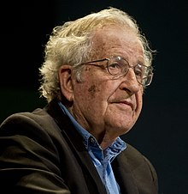
Language and Thought
Universal Grammar
Also called the “language of the mind”
Theory credited to Noam Chomsky about the innate nature of our linguistic capabilities
Posits that all languages across the world have common basic structures that comes from our innate linguistic capabilities
Goes against the “diffusion” model of language acquisition-- vocabulary is diffused, not language itself
Noam Chomsky. Image source: Wikipedia

Slide 13
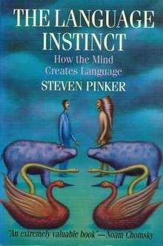
Language and Thought
Language Instinct
Theory proposed by linguist Steven Pinker that builds upon the argument of Universal Grammar, to argue for the innate nature of human linguistics
Distinguishes between “language” and “writing”-- where the latter is a cultural construct
Examples provided of “pidgin” languages adopted by babies, and creoles all of which have similar syntactic structures
Argues against the notion of “proper” language, and views linguistic constructs as “conventions”
Creole grammar from a Japanese labourer in Hawaii:
Da firs japani came ran away from japan come.
"The first Japanese who arrived, ran away from Japan to here."

Slide 14
Natural Language Processing

Slide 15

Natural Language Processing
Computational and statistical techniques to process human speech, with the aim of understanding and generating human-like language from machines
Image source: Wikipedia
History of NLP
1950: The Turing Test
Symbolic NLP (1950s -- early 1990s)
Rules and Symbolic Logic
Statistical NLP (1990s -- 2010s)
Distributional hypothesis
Neural NLP (present day)
Sequence Transformers

Slide 16
Natural Language Processing
Symbolic NLP
1956
“Logic Theorist”-- first computer program to manipulate Symbolic Logic, written by Herbert Simon, Allen Newell and Cliff Shaw.
1958
“Advice Taker”-- a hypothetical computer program proposed by John McCarthy, introduces natural language constructs represented using formal logic.
1959
General Problem Solver (GPS), written by Simon, Shaw and Newell used “reasoning as search” paradigm for goal-oriented universal problem solving machines. Problems represented as Well Formed Formulas (WFFs) or Horn Clauses, represented as DAGs with one or more sources and sinks.

Slide 17
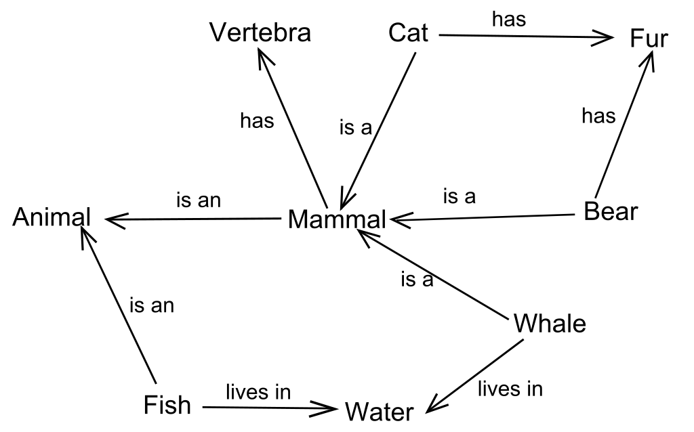
Natural Language Processing
Symbolic NLP
1959
Semantic nets, implemented by Richard Richens at the Cambridge Language Research Unit, proposed as an inter-lingua (intermediate representation) for machine translation of natural languages.
1964
STUDENT: AI program written by Daniel Bobrow for solving algebra problems written in natural language. For example:
“The number of people who walk into John’s restaurant is 20% more than twice the number of customers who walk into Bob’s restaurant. How many customers visited Bob, if John was visited by 50 customers?”

Slide 18
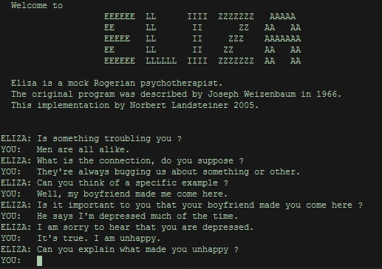
Natural Language Processing
Symbolic NLP
1966
First conversational AI called ELIZA, created at MIT by John Weizenbaum.
1980s
Advances in Knowledge representation, Knowledge Based Reasoning, and Knowledge Based Systems.
“Intelligence goes against the principle of parsimony-- it is based on the processing of large amounts of diverse knowledge in different ways.” -- Pamela McCorduck
By Unknown - http://www.le-grenier-informatique.fr/medias/images/eliza-title.jpg, Public Domain, https://commons.wikimedia.org/w/index.php?curid=70571280

Slide 19
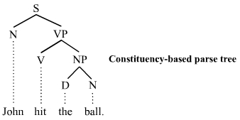
Natural Language Processing
Symbolic NLP
1980s
Development of Transformational Generative Grammars (TGGs) also called Constituency grammars
Based on the concept of I-structure and E-structure (internal and external structure) of language
Noam Chomsky one of the most prolific contributors in this area
Image source: Wikipedia

Slide 20
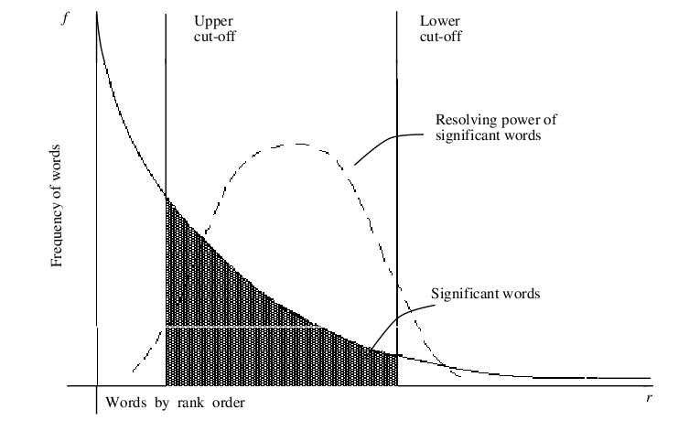
Natural Language Processing
Statistical NLP
Late 1990s
Also called “corpus linguistics”
Based on learning natural language constructs given a large corpus of text.
Distributional hypothesis: “Words with similar meanings tend to appear in similar contexts”
Cooccurrence as the statistical basis for learning latent semantics
Hebbian rule: “Cells that fire together, wire together”
Word distribution in documents found to be very skewed -- approximated by a Zipf distribution

Slide 21
Natural Language Processing
Statistical NLP
Statistical Language Model is based on assigning probabilities to sequences of words
A sequence of n-words taken as a unit is called an n-gram
Linguistic constructs derived from differences between the joint probability P(w₁, w₂, … w_{n}) of a sequence as against the product of their marginal probabilities: P(w₁)P(w₂)...P(w_{n})
Guess the meaning of the term greebel in the below paragraph:
“Everyday, I go to work in a greebel. There are two options for me. The 8:15 slow greebel takes 45 minutes, while the 8:30 fast greebel takes me to work in 30 minutes. If I miss both, I can take the purple line greebel at 8:40, but will need to change twice before reaching office, an hour later.”

Slide 22
Natural Language Processing
Neural NLP
2010s
A characteristic feature of statistical NLP is the vector space representation of terms and documents, making it possible to use linear algebra for linguistic processing
However, term vectors tend to be very high dimensional vectors-- leading to challenges collectively called the “curse of dimensionality”
A variety of techniques were explored for dimensionality reduction, including linear mappings like PCA, SVD, etc. and non-linear maps like MDS and LLE.
Advances in GPUs brought back Artificial Neural Networks (ANNs) to life, which can be used to learn non-linear mappings
Neural network based vector models are mostly in vogue today, called by the name embeddings.

Slide 23
Natural Language Processing
Neural NLP
A common drawback of Statistical NLP is the high amounts of pre-processing (lemmatization, stemming, etc) and feature extraction (NER, phrase identification, etc) necessary
Representation learning (or feature learning) that is characteristic of deep neural networks have been increasingly used lately to do away with manual feature engineering.
Seq2seq
Family of deep NN architectures to transform an input sequence into an output sequence. Early forms of neural AI, with architectures like RNN, LSTM, GRU, etc.
Transformer
Deep NN architectures based on self-attention that can address issues of long-range dependencies (LRDs) in sentences. Current SOTA for several NLP applications with pre-training and transfer learning. Examples: BERT, GPT, T5, etc

Slide 24
Natural Language Processing
LLMs and Foundation Models
Large Language Models (LLMs) also called Foundation Models, are neural network architectures trained on a large, natural language corpus (web scale dataset)
Typically, LLMs employ multi-head transformer, or Mixture of Experts (MoE) architectures, hosting hundreds of billions of parameters
Their training is based on Masked Language Model (MLM), along with other techniques like Reinforcement Learning with Human Feedback (RLHF)
LLMs are adapted to specific contexts using a variety of techniques:
Fine-tuning: Creating a domain-specific “demonstration” corpus and adjusting weights of final few layers of LLM architecture
Retrieval Augmented Generation (RAG): Using a vector database of sentence embeddings of domain-specific corpus for output generation, without changing LLM weights

Slide 25
NLP and AGI
Despite the impressive performance of LLMs in various NLP tasks, several “common sense” challenges still persist
Most of these problems include some form of coreference resolution
A common class of coreference resolution problems that require common sense understanding, are the so-called “Winograd schemas” named after Terry Winograd
Winograd Schema examples:
The city councilmen refused the demonstrators a permit because they feared violence.
The city councilmen refused the demonstrators a permit because they advocated violence.
The “they” in the two sentences refers to different nouns just by the use of specific verbs
The trophy doesn’t fit in the brown suitcase because it is too big. What is too big?
Jim comforted Kevin because he was so upset. Who was upset?

Slide 26
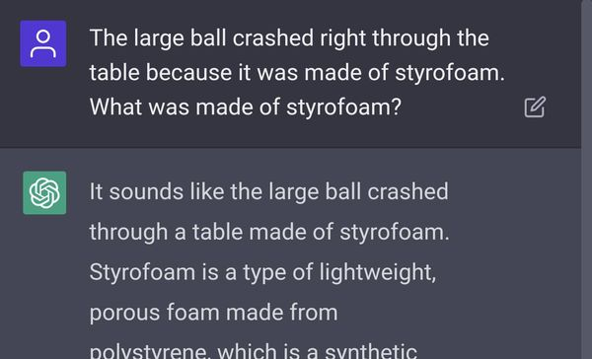
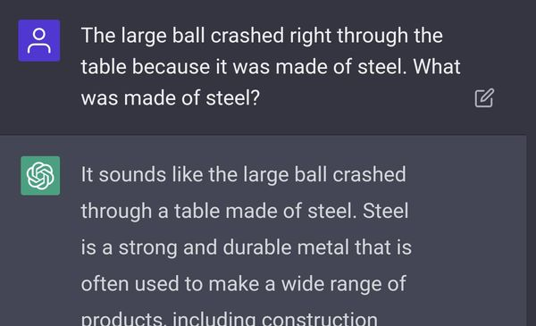
NLP and AGI
Although ChatGPT has been programmed for a number of Winograd Schema cases, it is still not foolproof.

Slide 27
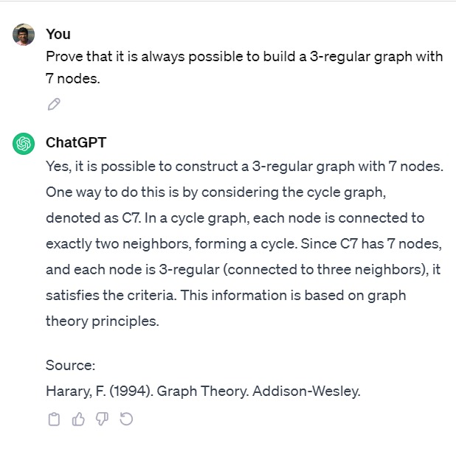
NLP and AGI
Probabilistic generation based on MLM poses significant risks when facing questions requiring precise answer formulations (like mathematical proofs)

Slide 28
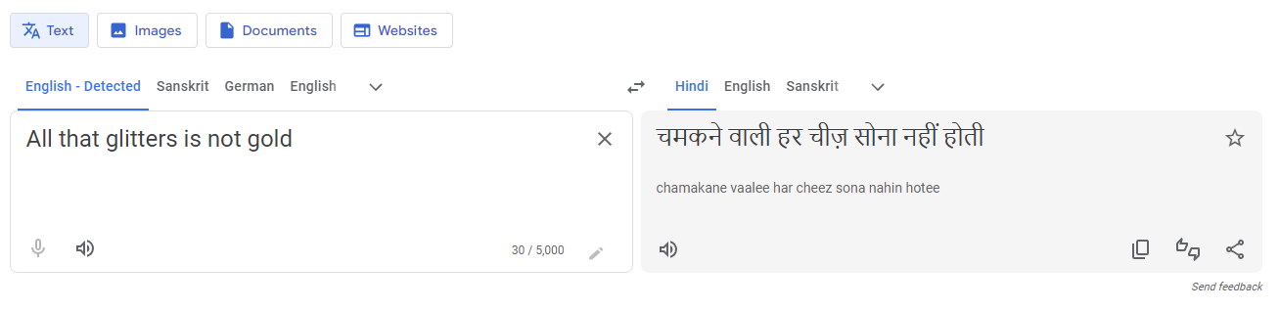
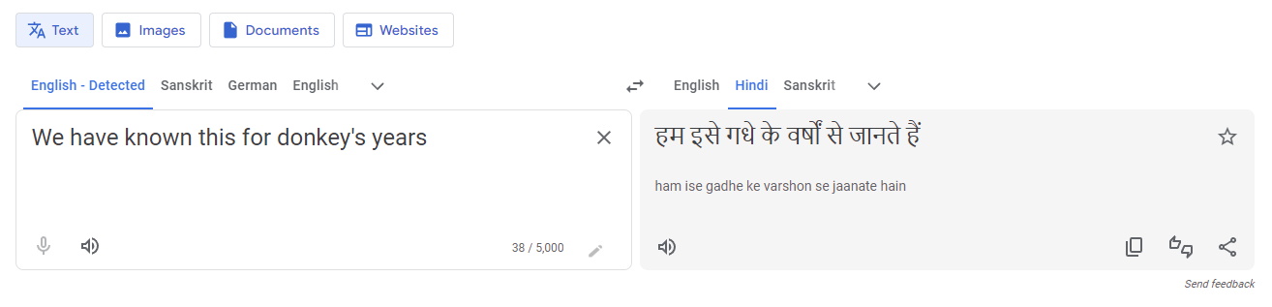
NLP and AGI
Language processing becomes particularly challenging with Machine Translation, when idiomatic constructs are involved..
Metaphor
Idiom

Slide 29
Natural Language Processing
Classical NLP Pipeline
Lexical Processing
Processing of raw text into semantic tokens
Stemming, Lemmatization
Phrase identification
Named entity recognition
Syntactic Processing
Grammar and parsing
Resolving ambiguity
Coreference resolution
Semantic Processing
Topic modeling
WSD, LSI, Embeddings
Narrative and discourse modeling
Meaning
Machine
Translation
Semantic Processing
General knowledge Domain Knowledge
Discourse Context
Question
Answering
Syntactic Processing
Conversational
UI
Language
Tokenization and Shallow Parsing
Lexical Processing
Text
(User Generated Content)

Slide 30
Neural NLP
Deep Learning Architectures
Meaning
Machine
Translation
Semantic Processing
General knowledge Domain Knowledge
Discourse Context
Question
Answering
Syntactic Processing
Conversational
UI
Language
Tokenization and Shallow Parsing
Lexical Processing
Text
(User Generated Content)

Slide 31
NLP with LLMs
Input
Deployment
Prompt engineering
Demonstration corpus
Pre
LLM
Fine-tuning
General knowledge corpus
VectorDB
RAG
Pre-training
Output

Slide 32
NLP Resources
Books
Christopher Manning , “Foundations of Statistical Natural Language Processing”, MIT Press, 1999.
Dan Jurafsky and James H. Martin, “Speech and Language Processing: An Introduction to Natural Language Processing, Computational Linguistics and Speech Recognition”, Pearson 2014.
Steven Bird, Ewan Klein, and Edward Loper “Natural Language Processing with Python: Analyzing Text with the Natural Language Toolkit”, O’Reilly.
Online NLP Resources
Awesome-NLP (https://github.com/keon/awesome-nlp)
Awesome DL for NLP (https://github.com/brianspiering/awesome-dl4nlp)
Dan Yurafsky’s NLP playlist on YouTube (https://www.youtube.com/playlist?list=PLoROMvodv4rOFZnDyrlW3-nI7tMLtmiJZ)

Slide 33
NLP Resources
ConceptNet (https://conceptnet.io/)
PyTorch resources (https://www.ritchieng.com/the-incredible-pytorch/)
AI4Bharat IndicNLP (https://indicnlp.ai4bharat.org/home/)
IndicNLP python library (https://pypi.org/project/indic-nlp-library/)
iNLTK (Indic NLTK library) (https://github.com/goru001/inltk)
Indic NLP Library (http://anoopkunchukuttan.github.io/indic_nlp_library/)
IndicNLP Catalog (https://github.com/AI4Bharat/indicnlp_catalog)
Online NLP Resources
Stanford NLP (https://nlp.stanford.edu/)
Apache OpenNLP (https://opennlp.apache.org/)
Penn TreeBank (https://paperswithcode.com/dataset/penn-treebank)
OpenAI (https://openai.com/)
WordNet (https://wordnet.princeton.edu/)

Slide 34
Mandate 1.1
LLM Fundamentals

Slide 35
Large Language Models
The “de facto” default approach to current day NLP
Based on transfer learning and fine tuning of large foundation models trained on very large corpus
LLMs typically designed on the Autoregressive Masked Language Model (MLM) and multi-head attention approach-- which we will study in more detail in Mandate 2
Some popular LLMs:
GPT 3.5, GPT 4 from OpenAI
BARD from Google AI
LlaMA from Meta AI
Falcon from the Technology Innovation Institute UAE
Claude by Anthropic AI
BLOOM LLM from BigScience
Alpaca by Stanford
ROBERTa Robustly Optimized BERT Pre-training approach

Slide 36
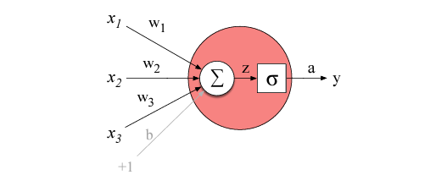
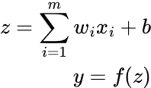
ANN Fundamentals
The building block of an Artificial Neural Network (ANN) is an “artificial neuron” which has its fundamentals in the McCullogh-Pitts model for ANNs
A single neuron comprises of two elements: weighted sum of inputs (with an optional bias) and an activation function:
Image source: Jurafsky and Martin (2023)

Slide 37
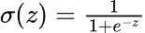
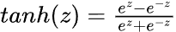
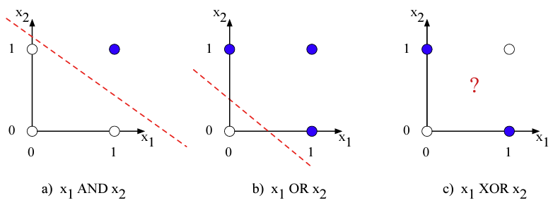
ANN Activation Functions
Most common activation functions include:
Sigmoid:
Tanh:
ReLU:
Other related topics:
Activation saturation
Vanishing gradient problem
XOR problem and linear separability
Universal approximation theorem

Slide 38
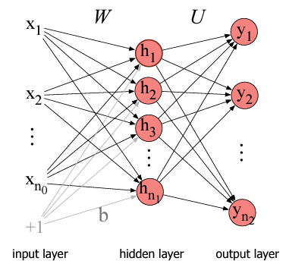
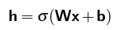
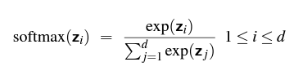
Feedforward neural networks
A multi-layer neural network with one input layer (called layer 0) and one output layer (called layer m) and one or more hidden layers, with each layer fully connected from the previous and to the next layer
All hidden layers compute weighted-sum activation from previous layers
The last layer uses softmax normalization to make its outputs into a stochastic vector

Slide 39
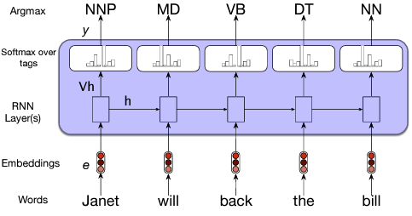
String Transducers
Also called Seq2Seq models, are one of the first major applications of ANNs to NLP tasks.
Seq2Seq models include RNNs and LSTM.
A seq2seq model is composed of an encoder and a decoder.
The encoder is responsible for processing the input sequence and capturing its essential information, which is stored as the hidden state of the network.
The decoder takes the context vector and hidden states from the encoder and generates the final output sequence. The decoder operates in an autoregressive manner, producing one element of the output sequence at a time. At each step, it considers the previously generated elements, the context vector, and the input sequence information to make predictions for the next element in the output sequence.

Slide 40
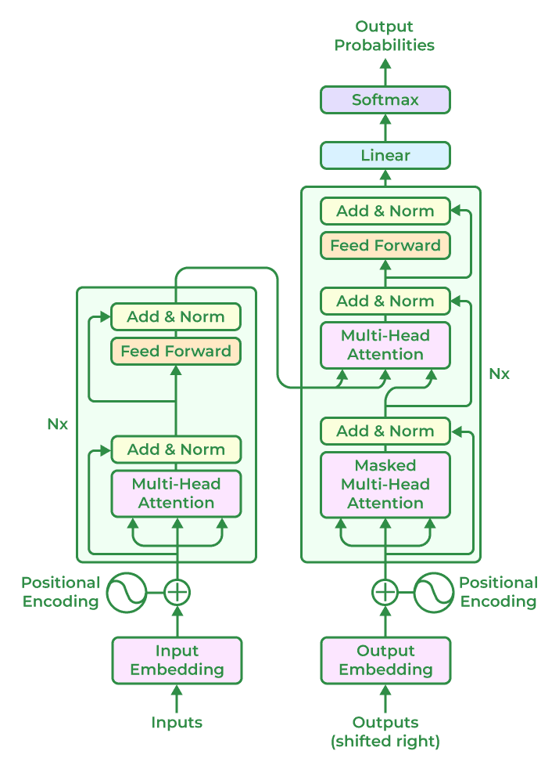
Transformers and Self Attention
Transformer is a deep, feed-forward neural network that uses multi-head attention mechanism to transform the input into the output
Transformers address several issues with Seq2Seq (some of which were partially addressed with bi-directional Seq2seq models) like:
Long range dependencies (LRD)
Complex coreference resolution
Bidirectional dependencies
Vanishing gradients

Slide 41

Large Language Models
While transformers are hugely successful in NLP, they are also very widely used in other ML domains like Computer Vision, Automatic Speech Recognition, Video Analytics, Generative AI, etc.
Each layer in encoder computes a weighted sum of all inputs from all its attention heads
First layer in decoder computes an output based on weighted sum of all elements of final encoder layer. Subsequent layers of decoder computes outputs based on weighted sum of all decoder attention heads
Source: https://blog.research.google/2017/08/transformer-novel-neural-network.html

Slide 42
LangChains
(Example LLM architecture)

Slide 43
LangChains
Compute architectures built on top of several pre-trained Large Language Models (LLMs) to combine their capabilities to perform more generic tasks
Such constructs are called LLMOps
LangChain library: https://github.com/hwchase17/langchain
LangChain Abilities:
Prompt management-- generic prompt interface for multiple LLMs
Chains-- creation of LLM sequences where output of one becomes input to another
Data Augmentation-- sourcing data from other external sources and restricting responses to data from a particular source
Agents-- autonomous decision-making about LLM actions
Memory-- persistent state between interactions

Slide 44
Foundation models
Open-source LLMs
BLOOM by BigScience
LLaMA by Meta AI
Flan-T5 by Google
GPT-J by Eleuther AI
Most open-source APIs accessible from HuggingFace community hub https://huggingface.co/
Proprietary (paid) LLMs
OpenAI
co:here
AI21 Labs
Anthropic
Bard

Slide 45
Foundation models
Importing OpenAPI keys
import os
os.environ["OPENAI_API_KEY"] = ... # insert your API_TOKEN here
Importing other LLM keys obtained from HuggingFace
import os
os.environ["HUGGINGFACEHUB_API_TOKEN"] = ... # insert your API_TOKEN here

Slide 46
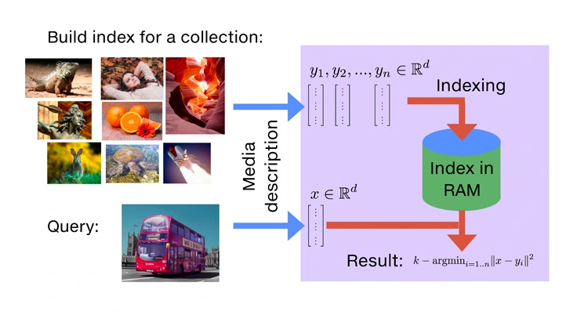
Vector Databases
Databases optimized for storage, retrieval and nearest neighbor search for multi-dimensional vectors
Example VectorDBs
Pinecone
Weaviate
Milvus
Faiss
Image source: https://engineering.fb.com/2017/03/29/data-infrastructure/faiss-a-library-for-efficient-similarity-search/

Slide 47
Prompt Management
# LLM-based sentence completion models
# Proprietary LLM from e.g. OpenAI
# pip install openai
from langchain.llms import OpenAI
llm = OpenAI(model_name="text-davinci-003")
# Alternatively, open-source LLM hosted on Hugging Face
# pip install huggingface_hub
from langchain import HuggingFaceHub
llm = HuggingFaceHub(repo_id = "google/flan-t5-xl")
# The LLM takes a prompt as an input and outputs a completion
prompt = "Alice has a parrot. What animal is Alice's pet?"
completion = llm(prompt)

Slide 48
Prompt Management
# Using LLMs to obtain Embeddings
# Proprietary text embedding model from e.g. OpenAI
# pip install tiktoken
from langchain.embeddings import OpenAIEmbeddings
embeddings = OpenAIEmbeddings()
# Alternatively, open-source text embedding model hosted on Hugging Face
# pip install sentence_transformers
from langchain.embeddings import HuggingFaceEmbeddings
embeddings = HuggingFaceEmbeddings(model_name = "sentence-transformers/all-MiniLM-L6-v2")
# The embeddings model takes a text as an input and outputs a list of floats
text = "Alice has a parrot. What animal is Alice's pet?"
text_embedding = embeddings.embed_query(text)

Slide 49
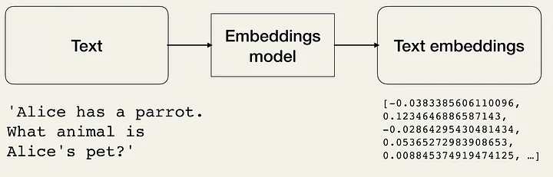
Prompt Management
Image Source: https://miro.medium.com/v2/resize:fit:720/format:webp/1*m-B8T61sERyREFwx56y3EQ.png

Slide 50
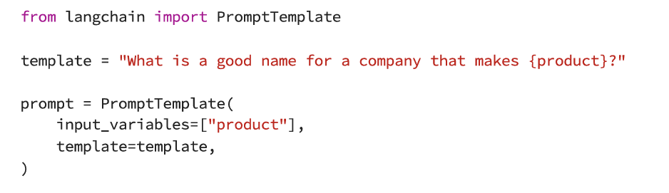
Prompt Templates
Enables creation of a class of prompt patterns by parametrizing specific details.
Templates can help in zero-shot prompt settings, where input variable may be some entity on which the LLM was not trained on.

Slide 51
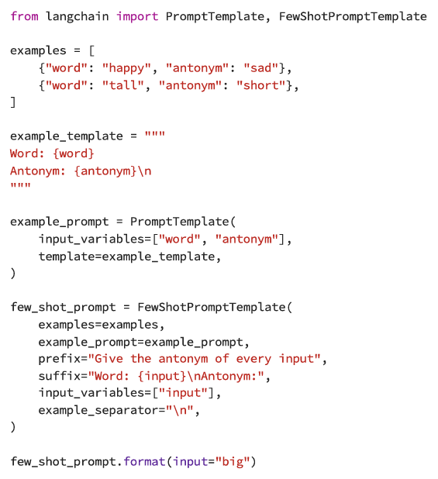
Prompt Template: Few-shot scenarios
FewShotTemplate helps creating a few sample examples of patterns we wish to train the LLM on, which are then presented as a prompt.

Slide 52
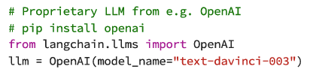
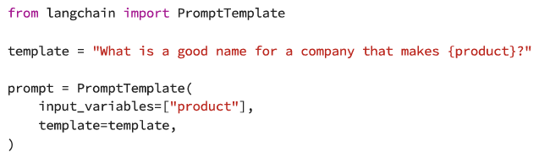
Creating LangChains
Create an LLM and prompt

Slide 53
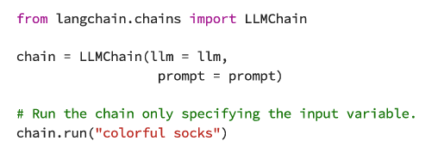
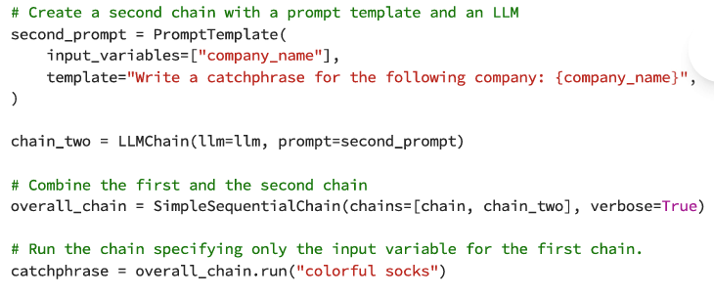
Creating LangChains
First element of the chain
Second element of the chain

Slide 54
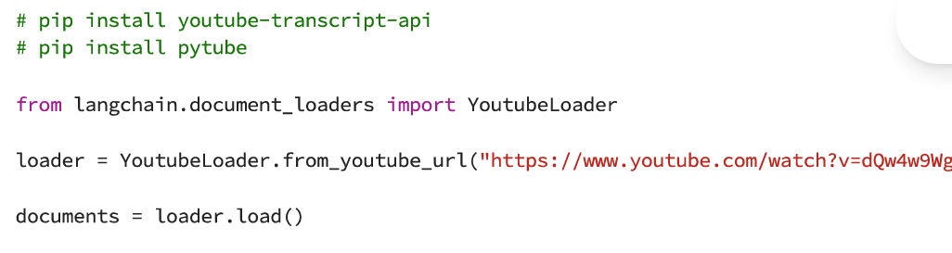
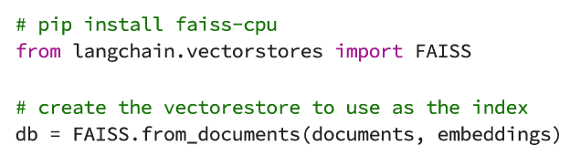
Accessing External Documents
Step 1: Load documents using document_loaders set of library functions
Step 2: Convert your document into a set of embeddings and store them in a vector store

Slide 55
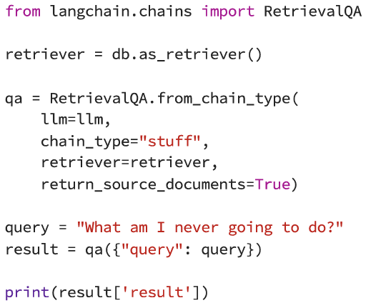
Accessing External Documents
Retriever service using external documents
Here, db is the vectorstore created earlier
Retriever service takes a dictionary comprising of a key “query” and returns results in another key entry called “result”

Slide 56
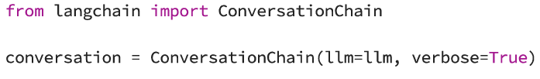
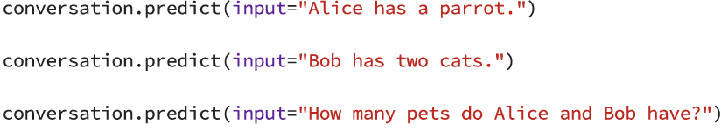
Creating Conversations
Conversations require a persistent interaction state, unlike Q&A, which are one-off interactions
ConversationChain library can be used to chain multiple interactions to form a conversation

Slide 57
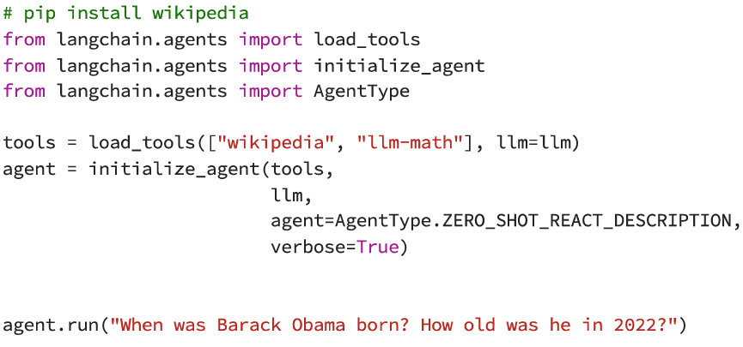
LangChain Agents
LangChain agents can be used to connect to external sources and perform calculations
Note, LLM in this example needs to be OpenAI. Does not work on Google T5

Slide 58
End of Mandate I

